Slide 1
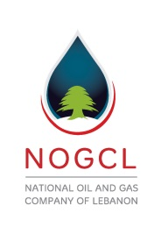
Petroleum Authority (PA) Oil & Gas Supreme Council Lebanese Armed Forces (LAF)
Parliamentary Governmental
Regulatory, Oversight & Audit National Security
Oil & Gas Ministry Sovereign Fund National Oil Company
Governmental NOC/Independent
Licensing & Fiscal Operation & Commercial
Oil Industry-Model designed uniquely for Lebanon
The government of Norway believes that Lebanon has less sophisticated, rather dire, institutional capacity.
Norway’s Petroleum Consultant, Mr. Farouk Qassimi, is convinced that Lebanon is a developing country and it should have only one entity to govern its Oil Industry… WELL, THEY ARE MISTAKEN!
Ministry of Finance/Central Bank
President
Prime Minister
Head of Parliament
Command Center

