Slide 1
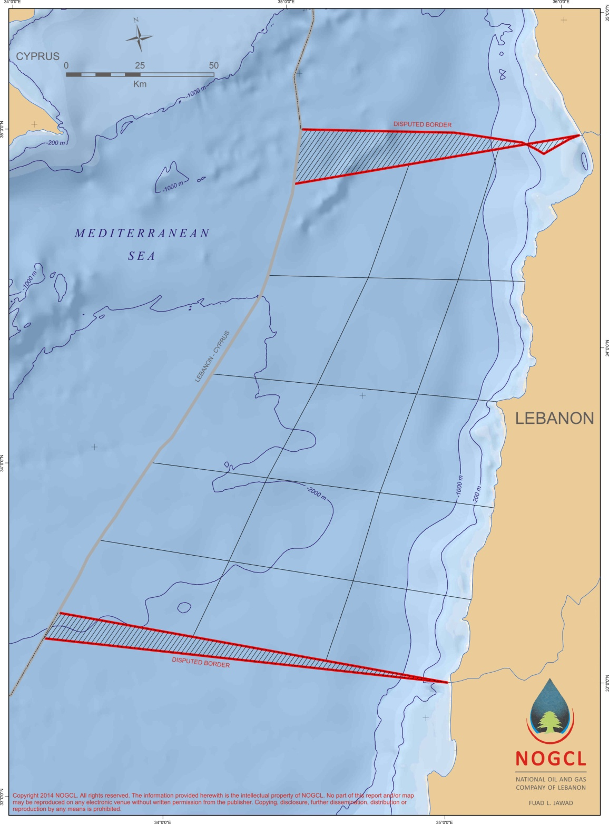
Proposed Block Delineation Offshore Lebanon / 15 Blocks
3
2
1
1223 km²
1222 km²
1223 km²
6
5
4
1222 km²
1223 km²
1222 km²
9
8
7
1222 km²
1223km²
1222 km²
12
11
10
1223 km²
1222 km²
15
1222 km²
14
1223 km²
13
1223 km²
1222 km²
- Blocks are equal in area size at 1223km2/each.
- Blocks Configuration includes the Continental Shelf.

