Slide 1
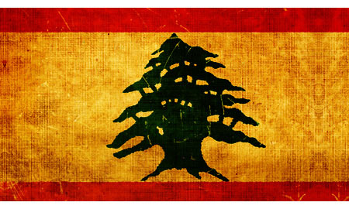
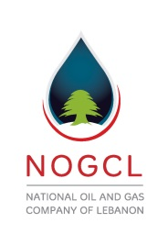
National Wealth Forum Conference
ESA – Beirut, Lebanon / June 8th, 2015
A Solution to Lebanon’s Oil & Gas and Moral Dilemmas
National Oil & Gas Company of Lebanon – NOGCL ©
Fuad L. Jawad – President / Petroleum Geologist
Copyright – 2013/2018© - NOGCL/Lebanon - All rights reserved

Slide 3
Bullet-Points
A. Undeniable Facts & Moral Issues.
B. Oil & Gas Science and Economics (101), Non-Technical.
C. Hydrocarbon Potential Onshore & Offshore Lebanon Vis à Vis the Regional Production Trend in Syria and Israel.
D. Oil Industry Models: Norway vs. Lebanon.
Problems with Lebanon’s Offshore Petroleum Law, 132/10, and the pending Decrees.
F. Amending the Petroleum Law and to establish the National Oil Company, NOW!
G. Influence of foreign elements on Lebanon’s Oil & Gas, in positive and negative ways.
H. Deep-Water Exploration Outlook, Worldwide.
I. How the National Oil Company (NOC) is the unique solution to Lebanon’s Oil & Gas.
J. The Licensing-Rounds strategy is not the only option available for Lebanon.
K. Closure: A courtesy of an independent Operator in the USA to the Oil & Gas students in Lebanon to examine samples of actual light Crude Oil (38 Gravity) from a Paleozoic Detrital Dolomitic Formation in an Oil Well drilled to a depth of 9,000ft in the Midland Basin, West Texas.

Slide 4
- Creation vs. Evolution: If you do not believe in God, I urge you to re-consider.
- Definition of the Truth, or the Universe moral Constitution: The Truth is whatever corresponds to reality.
A scholar once said: The Health of a Society is directly proportional to the people’s commitment to the Truth.
- Definition of an Expert: It is that entity (an individual or a company) with the education, knowledge and years of hands-on
experience in a particular field, or a profession. You are a “Loose Canon” without the years of HANDS-ON experience, as if I earn
my license to practice medicine when I exercise my hobby, reading Medical Journals.
Don’t fall into the trap. You can lead the horse to the water but you cannot force it to drink. We blame it on all but ourselves.
Embracing the good and let go with the bad. Lebanon’s best comes first; not you, not me, not special interest groups.
- Despite what some country(s) think, namely Norway or its Agents, I believe Lebanon has a decent institutional capacity.
However, it is my opinion that we need to gravitate to an industry model suitable to Lebanon’s Cultural Fabric.
- Adopt a policy of Inclusivity (based on Fairness and Equality) rather than Exclusivity (based on Selective Breeding and
Greed). Have you not seen what happened in Libya?
For now, let’s focus on the Essentials, TO DRILL, rather than the Secondary(s), which are cosmetics.
Essentials. Lebanon Oil industry’s foundation: Oil & Gas Ministry, National Oil Company, qualified PA, and the LAF/Security.
Secondary(s). Sovereign Funds, Petroleum Supreme Council, Etc… Kill the bear first, then, skin it!
- Unique Expertise in Oil & Gas Operation. There are over 1.5million Wells drilled in the USA. Most intense Oil & Gas
expertise offered on this planet.
- NOCs and World’s Reserves: Over 75% of the World’s Oil Reserves controlled by National Oil Companies. There are 50 major
companies in the world; 28 of them are NOCs.
FACTS & MORAL ISSUES

Slide 5
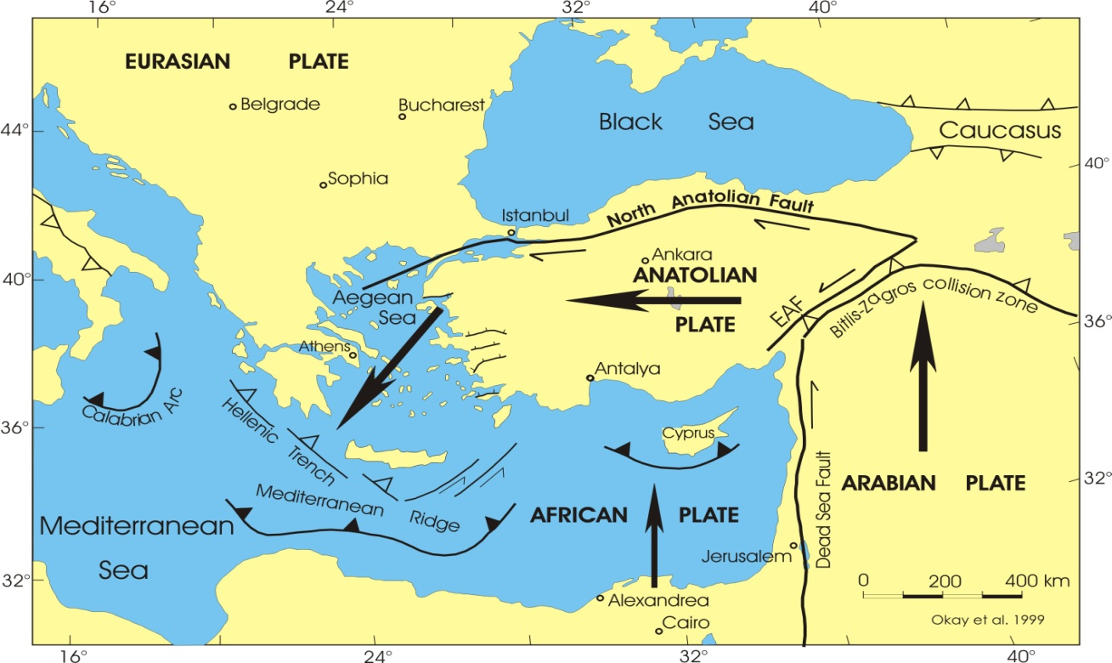
B. Oil & Gas Science and Economics, Summary/Non-Technical
GeoScience - 1: Regional Tectonics (The movement of Earth’s Crust layer) and Vertical Stress by the Sediments, could have
changed the orientation of the Structural Geology in EMED Basin causing Deformation (Transverse Faults, or
lateral Displacement) to the Reservoirs below.

Slide 6
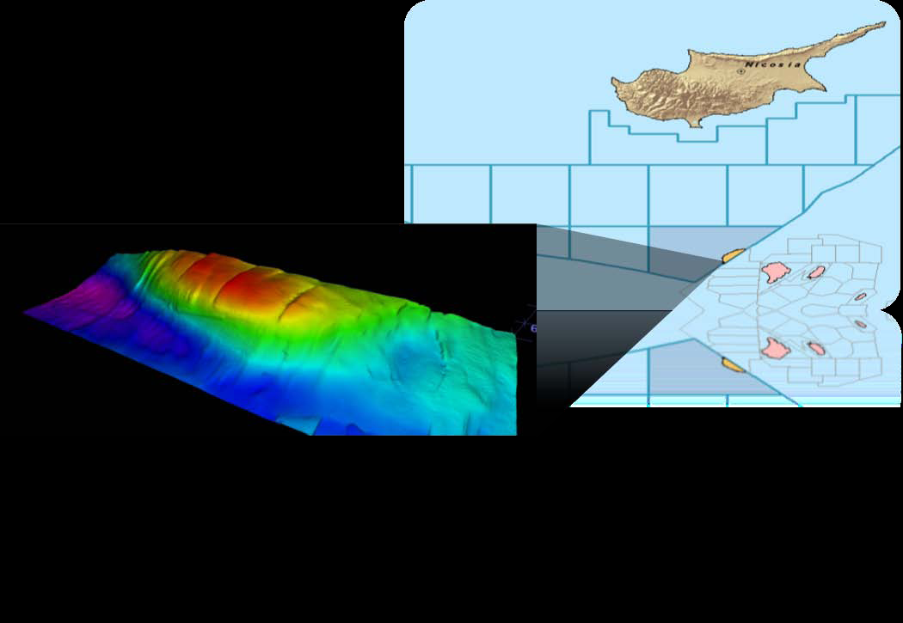
GeoScience - 1: Regional Tectonics (Cont’d). It could also be the explanation why the Anticline on Block-12 (Aphrodite),
Offshore Cyprus, was split into different compartments. Hence, the uncertainty over its Gas Reserves estimate
(from 9TCF to 5TCF).

Slide 7
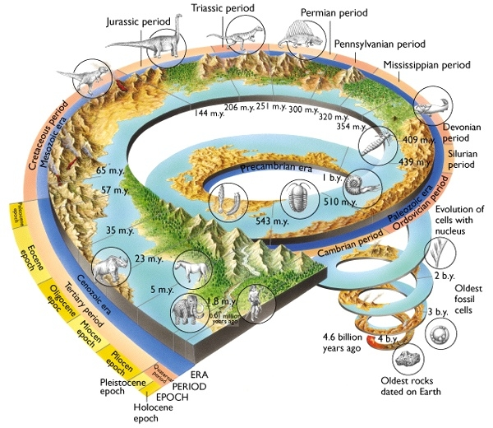
GeoScience - 2: Geological Times.

Slide 8
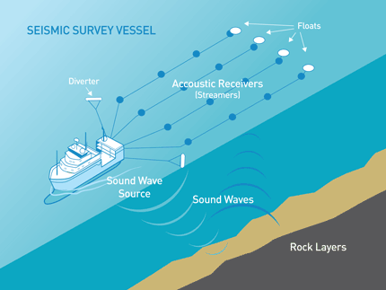
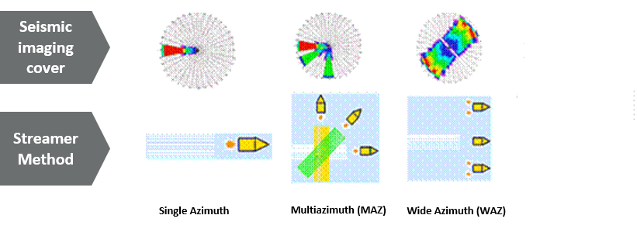
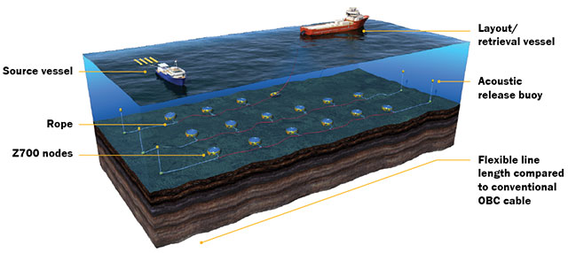
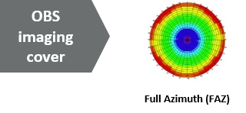
GeoScience – 3: Offshore Seismic
- 2D & 3D Offshore Seismic Imaging (Linear): Single to Multi-Azimuth, good quality but still conventional Surveys.
Coil (circular) Seismic Surveys.
Full Azimuth and Higher Resolution imaging, better Geometry than the 2D & 3D – Technology by Schlumberger.
Ocean Bottom Sensors, or Nodes (OBS, or OBN):
a. Full Azimuth and clear Geometry of HCIs.
Superior imaging as it captures Essential Data beneath the Salt intrusion that could cause distortion to Seismic signals.
Offshore Lebanon, We have 3000ft-thick Salt formation above the Gas-prone Miocene.
For obstructions, like Gas Clouds, when looking for Oil . The Nodes are inherently multi-component with Geophones and Hydrophones, allowing them to accurately record the waves.
d. Some are made with 4D (2 x 2D) capability: For effective Reservoir Monitoring.
e. Operates in deep Oceans, to 3000meters.

Slide 9
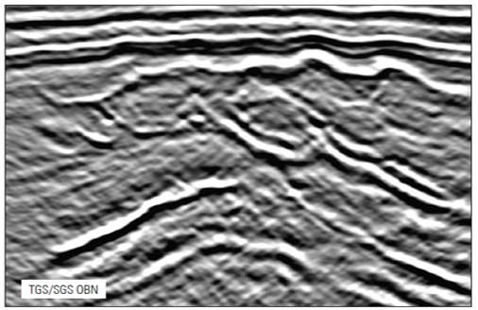
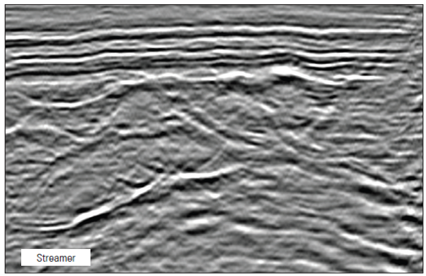
GeoScience – 3 (Cont’d)/Offshore Seismic:

Slide 10
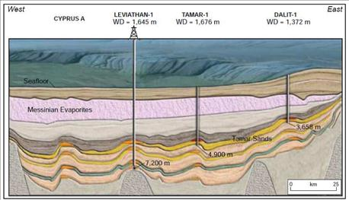
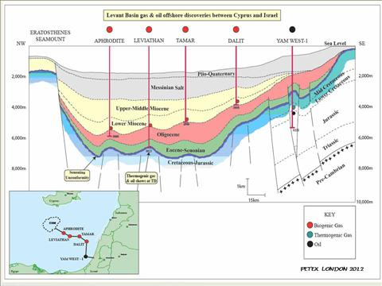
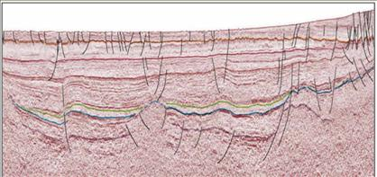
Estimated Reserves Offshore Lebanon and Value based on Science: DHI & Bright Spots
100TCF are equivalent to One Trillion USD. Valuation is based on $ 10.0+/mcf by 2018, but we will never realize the truth until we drill.
Oil & Gas Economics - 101:

Slide 11
Top Six Countries in Natural Gas (NG) Proven Reserves with 70%
of the World’s Reserves: 6600 TCF (2014)
Rank | Country | (TCF) Share of Total | Date of Information
1 | Russia | 1,680 25% | 2014 Estimated
2 | Iran | 1,190 17% | 2014
3 | Qatar | 890 14% | 2014
4 | USA | 308 5.0% | 2014
5 | Saudi Arabia | 288 5.0% | 2014
6 | Turkmenistan | 265 4.0% | 2014
NOGCL

Slide 12
Top Six Countries in Natural Gas (NG) - Production vs. Consumption World’s Annual Gas Production vs. Consumption: 121TCF / 120TCF
Rank | Country | Annual Production /Consumption (TCF) | Date of Information
1 | USA | 25/26 | 2014 Estimated
2 | Russia | 22/15 | 2014
3 | European Union | 6.2/19 | 2014
4 | Iran | 5.8/5.6 | 2014
5 | Qatar | 5.5/0.9 | 2014
6 | Canada | 5.4/3.6 | 2014
NOGCL

Slide 13
Top Six Countries in Proven Oil Reserves, representing 68% of the
World’s Oil Reserves: 1700 Billion Barrels
Rank | Country | (Billion of Barrels) | Date of Information
1 | Venezuela | 298 | 2014 Estimated
2 | Saudi Arabia | 270 | 2014
3 | Canada | 173 | 2014
4 | Iran | 155 | 2014
5 | Iraq | 141 | 2014
6 | Kuwait | 104 | 2014
NOGCL

Slide 14
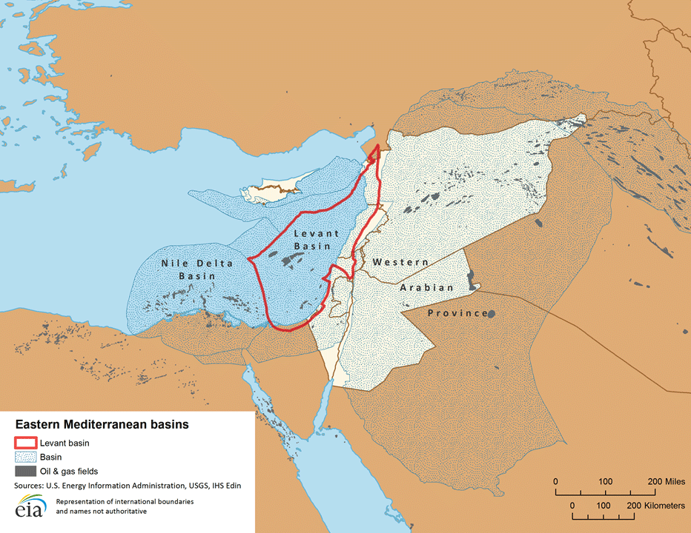
C. Oil & Gas Potential Onshore & Offshore Lebanon Vis à Vis the Regional Production Trend in Syria and Israel.

Slide 15
D. Oil Industry Models
Norway
Oil Ministry
Policy and Strategy Generation & Implementation
Regulatory Directorate – PA
Regulations & Oversight
NOC – StatOil
Operations

Slide 16
Petroleum Authority (PA) Oil & Gas Supreme Council Lebanese Armed Forces (LAF)
Parliamentary Governmental
Regulatory, Oversight & Audit National Security
Oil & Gas Ministry Sovereign Fund National Oil Company
Governmental NOC/Independent
Licensing & Fiscal Operation & Commercial
Oil Industry-Model designed uniquely for Lebanon
The government of Norway believes that Lebanon has less sophisticated, rather dire, institutional capacity.
Norway’s Petroleum Consultant, Mr. Farouk Qassimi, is convinced that Lebanon is a developing country and it should have only one entity to govern its Oil Industry… WELL, THEY ARE MISTAKEN!
Ministry of Finance/Central Bank
President
Prime Minister
Head of Parliament
Command Center

Slide 17
NATIONAL OIL COMPANY OF LEBANON (NOC-LB)
In the USA, almost uniquely, the mineral(s) rights are owned by the land or the lease owner. That is why we don’t have an
NOC in America. However, everywhere else as well as in this region, the minerals are owned by the government(s).
Hence, the need for National Oil Companies and, since the Gas Reserves Offshore Lebanon are scientifically proven, it is
time to establish our own NOC.
The NOC is the bone-structure (the Skeleton) of the Oil Industry and it defines the framework of its growth. Also, the
Oil & Gas Operational and Commercial aspects are mainly supported by two groups: a. The GeoScientists who suggest
the drilling location(s); and, b. The source of Financial backing that embraces the risk.
North Division Central South
Because of Lebanon’s cultural fabric, we recommend to assign three (3) divisions to the National Oil Company. Each Division will be managed independently from one another and each be responsible for 5 of the 15 Blocks, on next slide. However, the different division(s) work and report directly to the NOC’s Headquarters on all matters related to their operation.
NOC-LB Headquarters

Slide 18
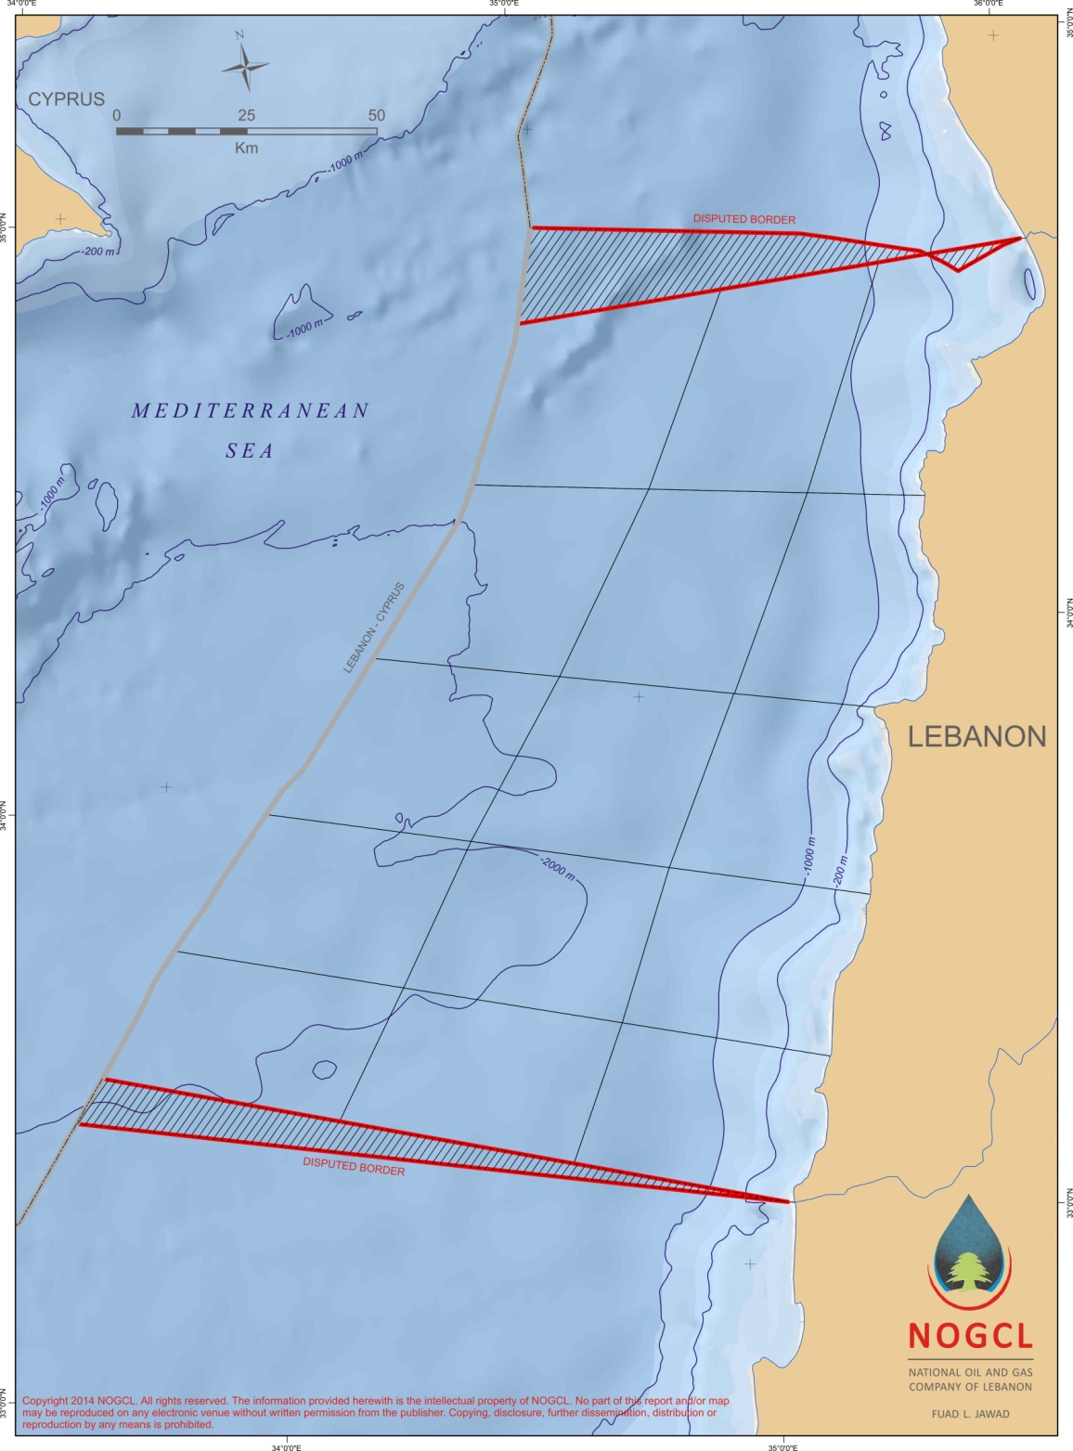
Proposed Block Delineation Offshore Lebanon / 15 Blocks
3
2
1
1223 km²
1222 km²
1223 km²
6
5
4
1222 km²
1223 km²
1222 km²
9
8
7
1222 km²
1223km²
1222 km²
12
11
10
1223 km²
1222 km²
15
1222 km²
14
1223 km²
13
1223 km²
1222 km²
- Blocks are equal in area size at 1223km2/each.
- Blocks Configuration includes the Continental Shelf.

Slide 19
E. Foist(s) and problems with Lebanon’s Petroleum Law, 132/10, and the pending Decrees
Despite the instability of its political climate, we have to understand that Lebanon’s institutional capacity is healthy. That is why the Oil & Gas Law(s) has to be re-examined and amended by the competent authority, the Parliament:
The Royalty of Four Percent (4%) to the State is very low;
The Participation of the State and its Working Interest (WI) are missing;
The State instrument, its National Oil Company (NOC), to engage in operation and participation has been ignored;
Lacking provisions on Taxation;
Lacking the Incentive to the IOCs to engage in Ultra-expensive prospect-leads;
6. Block Delineation: The number of Blocks (10) is not adequate; huge considering that Aphrodite Gas field is only 80sqkm.
The Law does not address any Logistical Option(s) to the IOCs where to operate in case of security problems in Lebanon;
8. Lack of Expertise. Walking the path and knowing the path are two different routines. Going to Norway, or to Scotland, for a year or two would not cut it. Without the many years of hand-on experience, he or she could work as “Interns” but cannot be qualified to the decision making capacity on Oil & Gas Operation or call themselves “EXPERTS”.
9. The Petroleum Law is highly Exclusive as it only involves that certain special interest group(s) and not all Lebanese to make it Inclusive which can be done by adopting the new Industry Model and not the one-entity Model designed for a developing country as proposed by the government of Norway and/or its agents.
Let’s examine a couple of FOISTs in the law, 132/10 (English Translation):
- Under many Articles, most used statement in the law: “… Based upon the opinion of the Petroleum Administration…”;
- Under Article 77: “… All laws or decrees which are in contradiction with this law shall be null and void“.
How could that be? How could a preliminary and incomplete law be above all laws of the land?
It is my opinion that the spirit of this law is certainly demeaning to Lebanon and the dignity of its citizens as it gives the absolute
power and control to the Petroleum Administration, and it alone. It seems as if the special interest group(s) have hired the few
members of the PA to oversee other than its regulatory mission.

Slide 20
F. Amending 132/10, the two pending Decrees and add necessary provisions:
National Oil Company: Basic element to a successful Oil Industry in Lebanon is the State participation by means of its
NOC, for it is the only venue to operate with the IOCs on behalf of the government and to employ Lebanon’s university
graduates interested in the Petroleum Sector.
Royalty : Potential Gas-Reserves Offshore Lebanon proven, means less risk to IOCs, just increase the Royalty to Fifteen Percent 20%.
Blocks Delineation: Increase the number from 10 to 15 Blocks and award down to the bottom of “Cenozoic” only.
Add the definition of the Working Interest (WI) to the Petroleum Law (132/10): Available upon request.
Taxation & Cost Recovery: The 15% Tax on corporate profit is adequate. And, depending on the Agreement Model,
Twenty Percent (20%: CAPEX 15%, and OPEX 5%) for the Cost Recovery on Production is adequate, until Payout.
VI. Tax Exemption: A grace period of 3 to 5 years to the IOCs would be conducive.
Foreign Representation in Lebanon: Every International Supplier/Manufacturer desires to sell Oil & Gas related Products
and Services to the State and/or to any Operator (IOC) working within the Territory of Lebanon, Onshore or Offshore, must register
and have a local Representative, an Oil & Gas entity (strictly Lebanese), licensed by the competent authority(s) in Lebanon.
Security Measure, serves as an Option: Give the right to the IOCs to operate Lebanon’s discoveries from a
neighboring country, like Cyprus.
Social Programs: At their own cost, IOCs would need to commit to the development of certain social projects in
Lebanon, such as to build Hospitals, Schools, Roads, Etc…
Less Power to the Petroleum Administration. Let the “PA” stay within its Regulatory duties, no Operation.
Amendments to the Petroleum Law (132/10) could be done rather swiftly. The Parliament could convene on an “urgent session” to
make the changes. It could be done within 30 to 60 days and we could have the NOC up by year end, 2015.

Slide 21
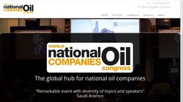
G. Influence of foreign elements on Lebanon’s Oil & Gas, in positive and negative ways:
- Heavy reliance on foreign Consultants is (-) because it could threaten Lebanon’s National Security.
And, it would only results in some experience (on need-to-know-basis) but at high cost and loss of identity.
- Putting your eggs in one basket is (-) is as disastrous as inviting the bear to your vineyard.
Signing an Agreement with a single foreign entity (NORWAY) could be damaging, if not illegal (Anti-trust laws).
- Russia, USA, Europe, Israel and Speculators (-). This is because each has its own agenda but not necessarily
within Lebanon’s best interest. The delays to drill for Oil & Gas Offshore Lebanon would only benefit special interest groups.
- World’s Oil & Gas Production Regulations and Quotas (+/-). Looking at Lebanon with mercy to pay its
debt, or, we don’t need your Gas if you continue with lack of professionalism, deception and arrogance.
- Rally International Support (+). Let’s face it. The international community is concerned about the consequence
of Dual-usage of Oil & Gas Revenue in Lebanon, Commercial and Military.
- Domestic and Regional Conflicts, Exercise restraint (+). In case of any doubt, Lebanon can easily operates
offshore from a neighboring country.
- Join the world’s Congress of National Oil Companies (+). Why?

Slide 22
H. Deep-Water Exploration Outlook
Oil Prices, fallen by 40% to around $ 60/barrel;
WTI (Texas) Crude is selling in the open market in USA at about 10% discount, or $ 54/barrel.
Natural Gas Prices, 2014 to present time.
a. USA: $ 2.75/mcf (million BTU), a drop by 25%
b. Europe: $ 8.50/mcf, a drop by 25%.
Demand and Supply.
Oil & Gas demand is on the increase with no shortage in Oil & Gas supplies in the foreseeable future.
Oil & Gas prices to remain the same over next 2 to 3 years.
A significant change in Oil prices, if any, would be caused by two black-swan variables:
a. A serious regional conflict, war, in the Middle East; and,
b. The greed of speculators and predators.
Lower Oil prices has greatly contributed to the slow activities in Deep Water Exploration, true.
However, Deep water will not be ignored because of the major discoveries, on global scale, last several years.
5. Gas Field financial tip. The more wells the IOCs drill in deep water Offshore Lebanon to develop the same Gas Field the less the ROI (Return on Investment) would be. A financial evaluation on a 3tcf Gas field shows that the ROI is at “15 to 1” if one consortium of IOCs drills 2 to 3 wells while it is 8 to 1 if 5 wells are drilled.
6. Deep-Water Exploration is on the down-swing now and for 3 more years. The transformation, from peak (in 2012/ 2013) to trough, has given rise to less cost to drill, more Offshore Rigs available to hire and better technology to yield Efficiency to Completion time and less Wells drilled to Production. Thus, the cost of Drilling and Operation in Deep Waters is way down, by over 25%. And, this would improve the Return On Investment (ROI) to the IOCs and Lebanon.
Consequently, Deep Water Exploration will stay with us and this industry will grow strong. The Mediterranean Sea and
other Basins have been hunted. However, investment would be selective and tend to find its way to more stable region(s).
And so, NOW is the perfect time for Lebanon to move forward on the present opportunity to establish our NOC to drill
Offshore, to benefit from the lower Drilling Cost and to reach for higher Natural Gas prices in 3 years, by 2018.

Slide 23
I. We promise you, the Citizens and the New Oil & Gas Generation of Lebanon
That our team is reliable and is in a position to help deliver the following:
To co-establish and to co-govern a vibrant National Oil Company (NOC) that is independent and non-political, just like Lebanon’s Army and the Central Bank. This is because Lebanon’s Oil & Gas wealth is for all Lebanese, no exception. It is our opinion that the NOC managed by Experts with years of hands-on experience, NOT Trainees, is the best solution to unlock Lebanon’s HydroCarbon potentials.
To qualify the NOC, financially and technically, to operate and to drill Offshore or Onshore within Three (3) years.
Within Two (2) years from date of its establishment, to hire and train One Hundred (100) University - Oil & Gas graduates (all Lebanese) to work for the NOC. Thus, the policy of Inclusivity.
To discover commercially viable quantity of Natural Gas, Offshore or Onshore, by year 2018 and not by 2022;
To give Lebanon an NOC it deserves and the necessary exposure to help it enter into the World’s Congress of National Oil Companies.
To adopt a policy of Inclusivity so many Lebanese could participate and/or benefit from the NOC, in one form or another.
To rally international support so we can Explore for Oil & Gas Offshore Lebanon without problems with its neighbors;
To work with passion and integrity for the best interest of Lebanon, then the individuals, and to bring God’s Blessings closer to Lebanon in the hope to unit the country rather than the “Curse” of the status-quo of division and despair.
However, for this noble and patriotic objectives be a reality, we would need:
To understand that Lebanon’s Institutional Capacity is healthy and to work with an industry model that is suitable;
The support by all political parties in Lebanon to stop wasting time and to establish the NOC before end of this year;
For the Petroleum Administration (LPA) to preserve and clench to its regulatory duties and be patient; and,
Last, but not least, the necessary funds (Initial Capitalization), which can be easily raised once the NOC is established.

Slide 24
The Licensing-Round business strategy is not the only contractual option for Lebanon to commence with our Oil & Gas business.

Slide 25
Oil & Gas University Students - Lebanon:
Come down to stage to examine actual samples of light Crude Oil from the Midland Basin (West Texas) – Gravity 38
THANK YOU!
Fuad L. Jawad – Geologist / Oil & Gas Consultant
National Oil & Gas Company of Lebanon – NOGCL ©
E-mail: fuad@nogcl.com
Telephone: + 961 3 494500
PETR SERV™ INTERNATIONAL
Larnaca, Cyprus
E-mail: fuad@petroservint.com
Telephone: Office + 357 24 625666
Mobile: + 357 97 885511

